Slide 1
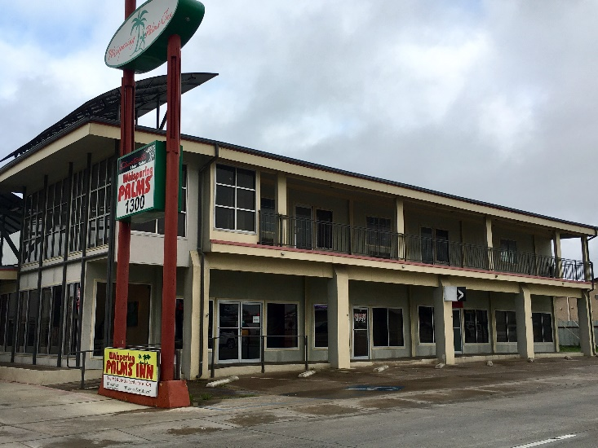
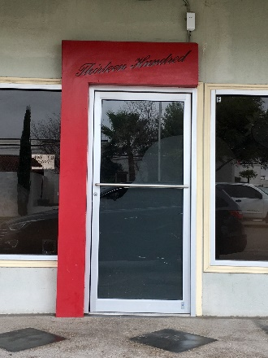
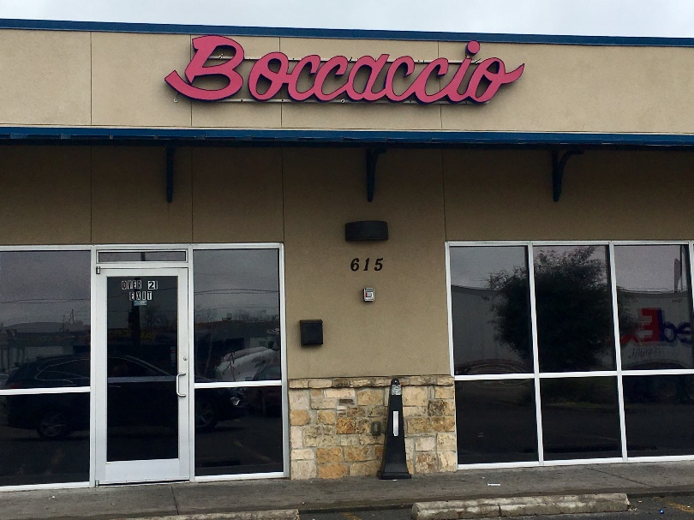
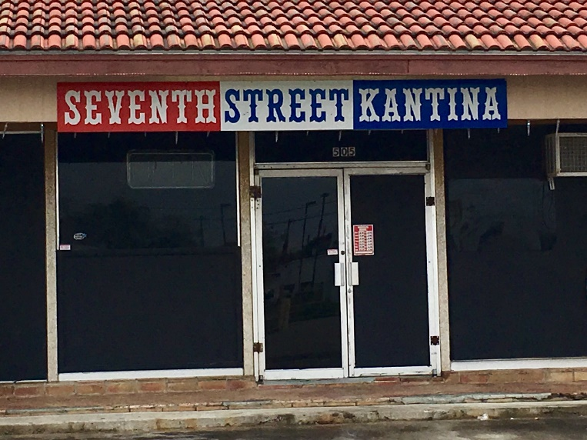
Local Off-Limits Establishments
1300 Bar (1300 Veteran’s Blvd.)
*Located at the Whispering Palms Motel
Establishments Permanently Off-Limits
To Armed Forces Personnel (Del Rio, TX)
7th Street Pub (505 E. 7th St.)
*Located near intersection of Veteran’s Blvd and Seventh St
Boccaccio (615 E. Gibbs St.)
*Located next to Little Ceasars Pizza and Wing Stop
Notes:
CLIFFS: No diving from cliffs due to large rocks/boulders under water line. Air space from top to bottom off limits. There have been several deaths caused from diving from the cliffs.
BRIDGE: No trying to walk or beat trains across. No jumping or diving from railroad bridge due to water level fluctuating.
RIO GRANDE: No water activities on Rio Grand from the dam to the bridge area (13.2 miles), due to Weir Dams. Water flows over dam and creates undertows that keep pulling you back under.
ESTABLISHMENTS: Boccaccios, 615 E. Gibbs St/Thirteen Hundred Bar, 1300 Veteran’s Blvd/7th Street Bar, 505 E 7th Street. Off-limits to help maintain the health, safety, welfare, morale and discipline of Armed Forces Personnel

Slide 2
Local Off-Limits Establishments
Establishments Permanently Off-Limits
To Armed Forces Personnel
San Antonio, TX
Cracker Box Palace
622 West Hildebrand Ave.
Planet K
5619 Evers Rd.
1015 East Mulberry Ave.
2803 Goliad Rd.
2138 Austin Hwy
**All Atascosa, Bandera, Bexar, Comal, Guadalupe, Kendall, Medina and Wilson County Locations**
Players Club of San Antonio
11431 Perrin Beitel Rd.
MJM Autohaus
10740 Hillpoint #4
VIP Spa
6136 Bandera Rd.
Notes:
CLIFFS: No diving from cliffs due to large rocks/boulders under water line. Air space from top to bottom off limits. There have been several deaths caused from diving from the cliffs.
BRIDGE: No trying to walk or beat trains across. No jumping or diving from railroad bridge due to water level fluctuating.
RIO GRANDE: No water activities on Rio Grand from the dam to the bridge area (13.2 miles), due to Weir Dams. Water flows over dam and creates undertows that keep pulling you back under.
ESTABLISHMENTS: Boccaccios, 615 E. Gibbs St/Thirteen Hundred Bar, 1300 Veteran’s Blvd/7th Street Bar, 505 E 7th Street. Off-limits to help maintain the health, safety, welfare, morale and discipline of Armed Forces Personnel

